Slide 1
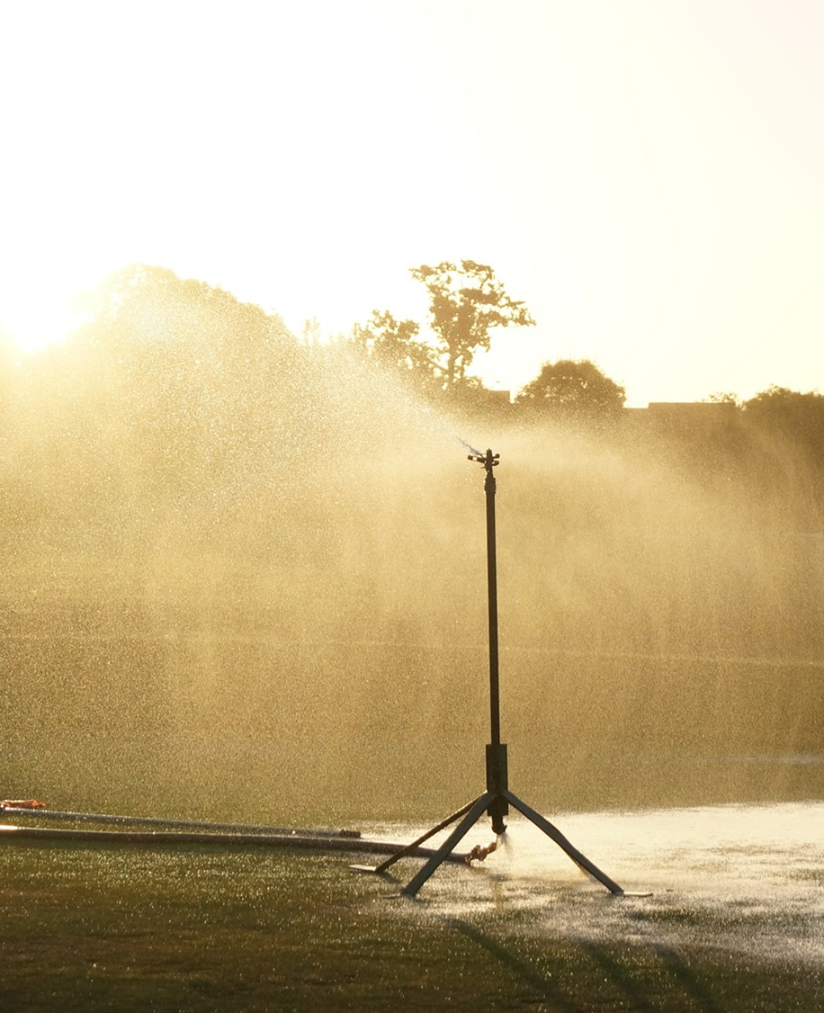
Outreach & Education
Water Conservation
Candace Schaible
Horticulture & Urban Water Use

Slide 2
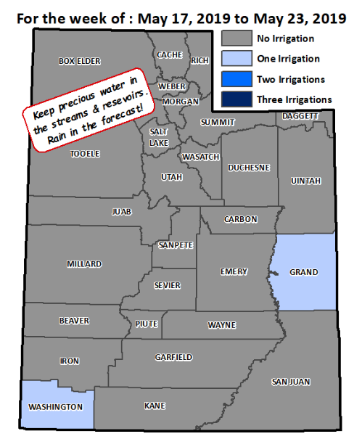
Iron County Water Check Program
Slowtheflow.org

Slide 3
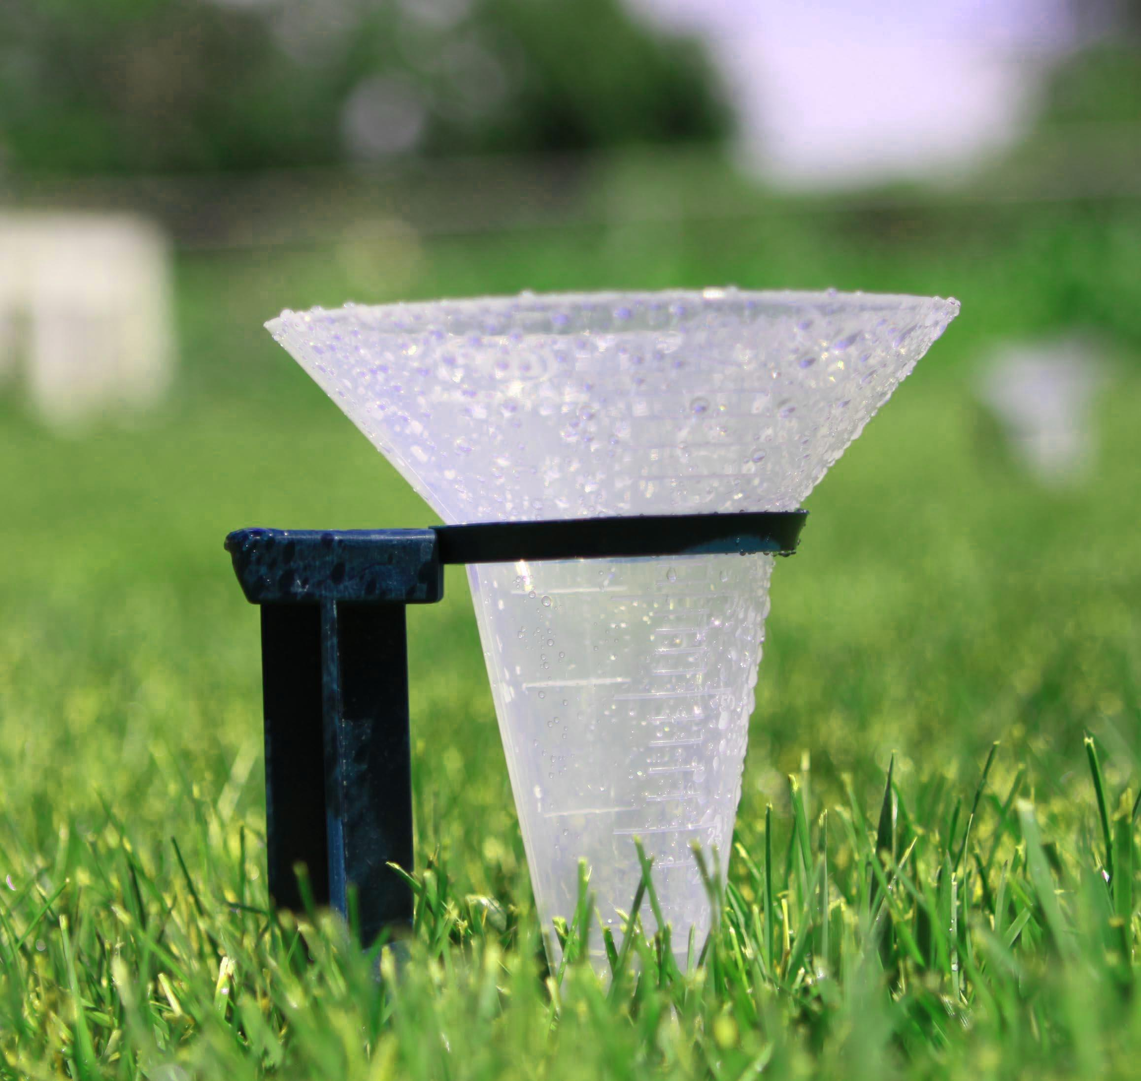
Water Check Program
Precipitation Rate
  Create a customized watering schedule
Distribution Uniformity
  design changes or need maintenance are discussed
Notes:
Developed partnership, funding source was the Central Iron County Water Conservancy District, to upgrade a few irrigation systems.
Goal or hope was to demonstrate water savings and hopefully enough savings to justify future upgrades, with funding provided by the city and school district.

Slide 4
Average Existing vs. Recommended Irrigation Schedule
Notes:
For our analyses here, a baseline index was calculated by averaging the annual index for the two years prior to the water check, and a response index was calculated by averaging the annual index for two years after the water check. The baseline index characterizes water use prior to the water check and establishes a baseline from which to measure post-water check water use characterized by the response index.

Slide 5

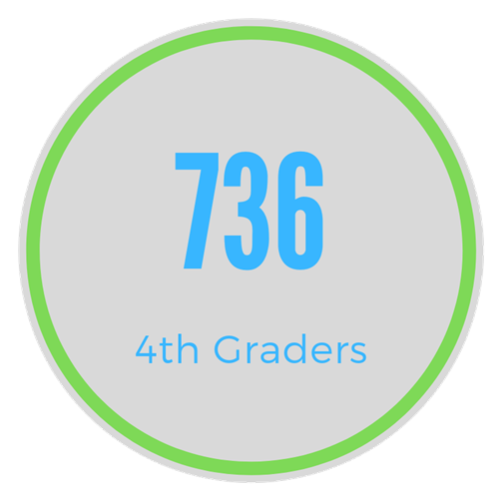

4th Grade Water Fair

Slide 6
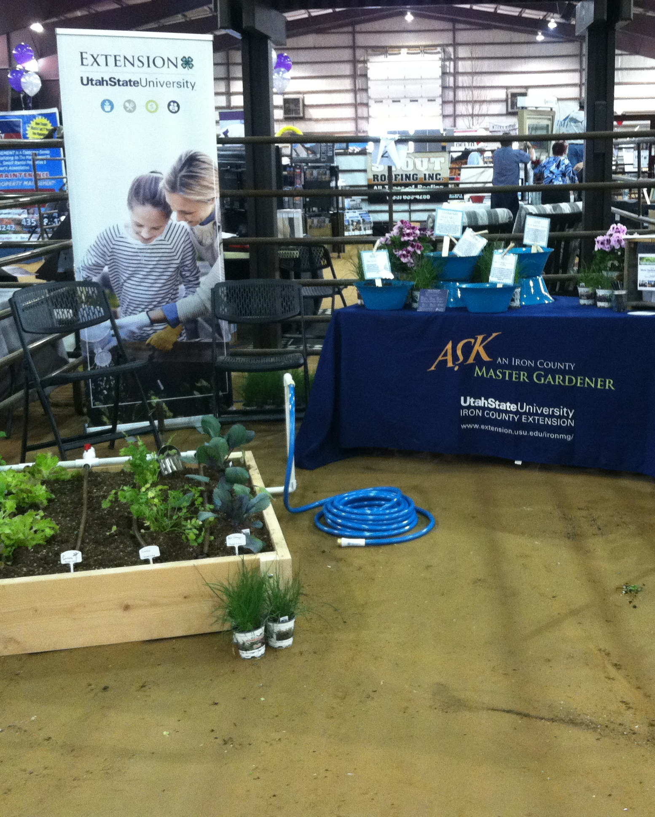
Information Booths
Water Festival
Spring Home & Garden Show
Iron County Fair

Slide 7
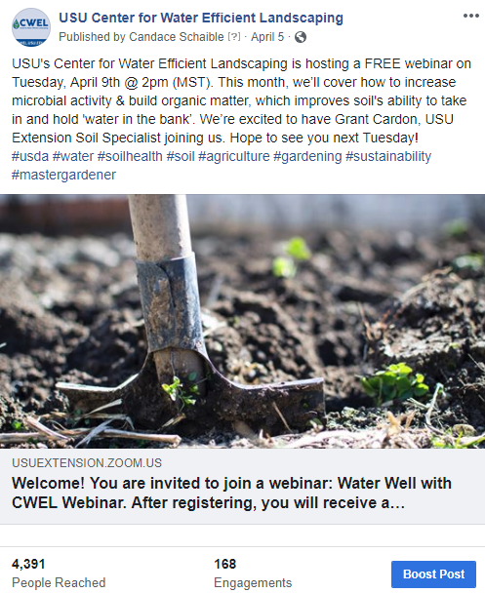
Monthly Webinar
USU Center For Water Efficient Landscaping

Slide 8
Water Savings Associated with ET-Based Irrigation Scheduling

Slide 9
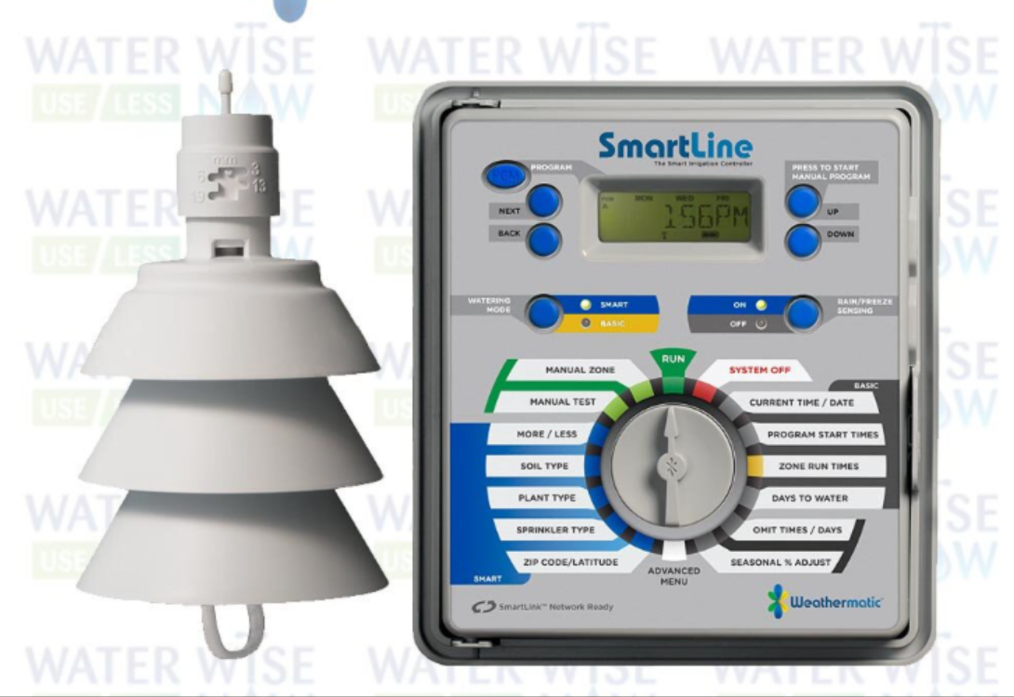

Controller
Weathermatic’s SmartLine
  Web interface
  Flow sensor
  On site weather station
  Phone application

Slide 10
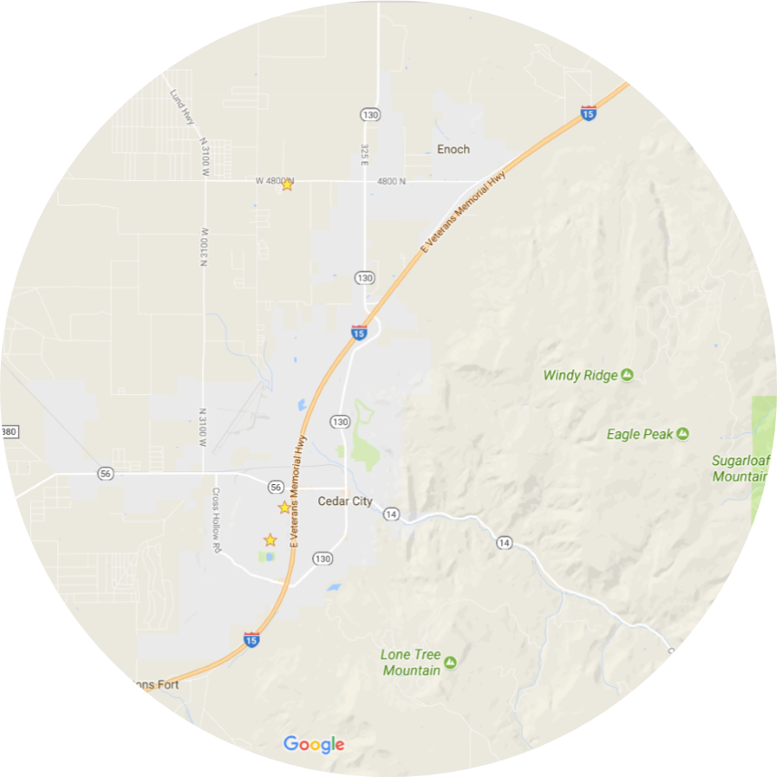
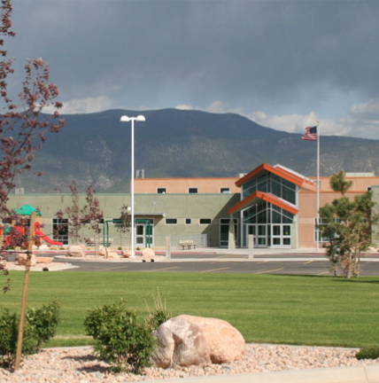
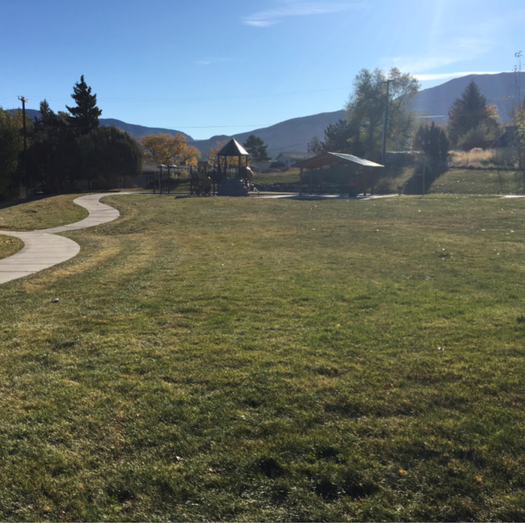
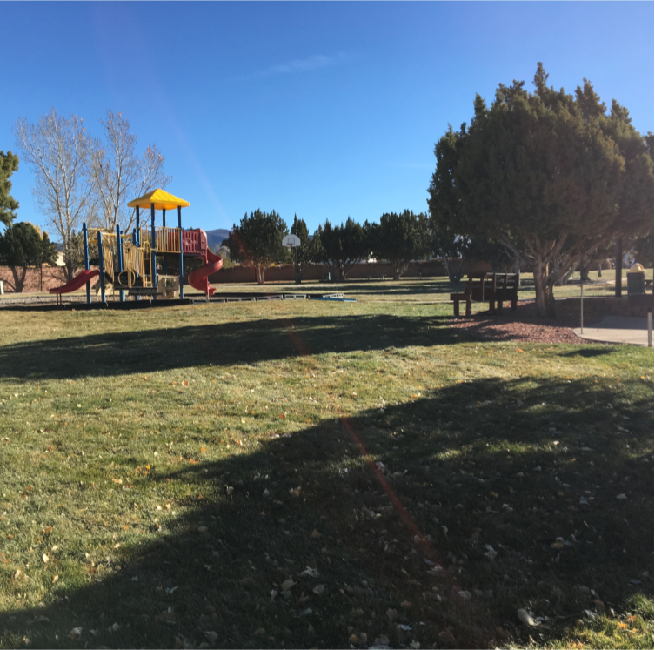
Project Locations
Three Peaks Elem
Three Peaks Elementary
Ridge Park
Hillcrest

Slide 11
Three Peaks Elem
Total turf, 4.95 acres
Takes 134,373 gallons to apply 1” of water
Notes:
Pulled water use data for 3 yrs. prior to the project from all three sites to establish a baseline for water usage
0 = turf water need
Estimated using reference ET x Kc of .8 for cool-season turf, minus precipitation
Assumed 70% distribution uniformity
11.12” (3 yr. avg)

Slide 12
Three Peaks Elementary
Total turf, 4.95 acres, 134,373 gallons =1” of water
Notes:
Controllers were in stalled in July of 2014
2015, turf was removed and reestablished in areas
Roughly 6” annual reduction
2011, 12.68
2012, 11.3
2013, 9.37
2014, 5.8
2015, 8.9
2016, 3.75
2017, 13.9
2018, 27.5

Slide 13
Ridge Park
Total turf, .65 acres
Takes 17,600 gallons to apply 1” of water
Notes:
Over irrigating by 78” (3yr. Avg) a season

Slide 14
Ridge Park
Total turf, .65 acres, 17,600 gallons = 1” of water
Notes:
12.63” over application vs. 78”
2011, 60.5
2012, 74
2013, 99
2014, 48
2015, 14
2016, 11
2017, 19
2018, 48

Slide 15
Hillcrest Park
Total turf, .68 acres
Takes 18,536 gallons to apply 1” of water

Slide 16
Hillcrest Park
Total turf, .68 acres, 18,536 = 1” of water
Notes:
2011: 3.61
2012: -6.76
2013: 6.16
2014: -10.3
2015: -8.4
2016:-7.3
2017: -19.49
2018: 47.3

Slide 17
Annual Application Summary 2011-2016
Notes:
For our analyses here, a baseline index was calculated by averaging the annual index for the two years prior to the water check, and a response index was calculated by averaging the annual index for two years after the water check. The baseline index characterizes water use prior to the water check and establishes a baseline from which to measure post-water check water use characterized by the response index.

Slide 18
Summary
Water Savings (2.5 yrs)
Cost Benefit Analysis

Slide 19
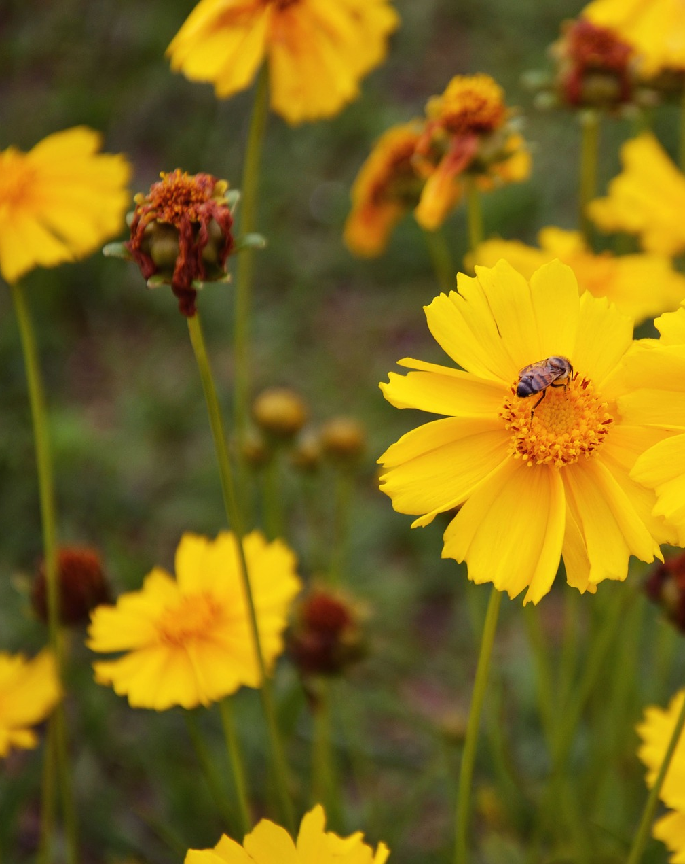
Coming soon…
Water-Wise Demonstration Street

Slide 20
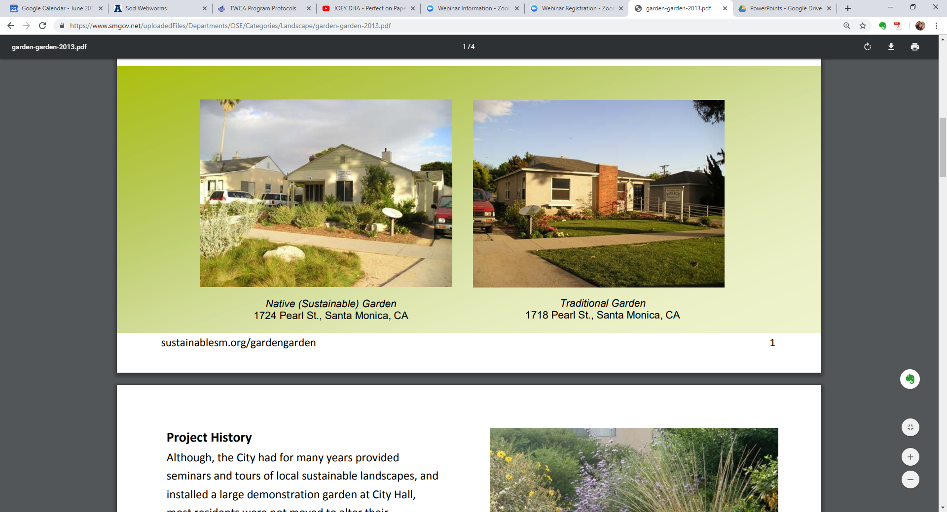
Garden/Garden Project
Santa Monica, CA

Slide 21
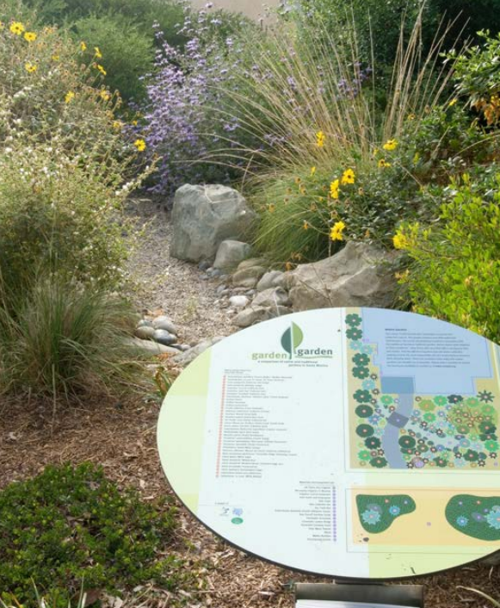
Garden/Garden Project
Santa Monica, CA
Native Garden uses
Uses 83% less water
Generates 56% less green waster
Requires 68% less maintenance

Slide 22
Thank you!
Candace Schaible

